Slide 1
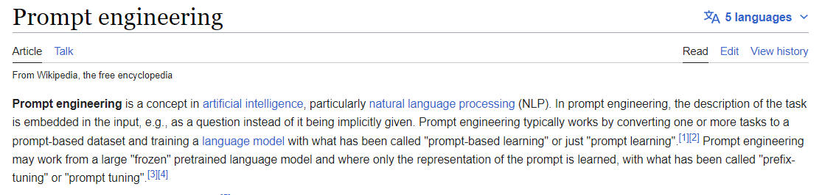
Future of Work
Introducing a new skill/role: the ‘Prompt’ engineer
Social media post: Post in [language]: #[Title] [One paragraph] Tags: [List relevant 3 hashtags]
AD-strategy: Write an AIDA for (product or service)
Meta-description: Generate a metadescription of maximum <155 bytes>, for a webpage about (add topic)
Write a LinkedIn post about (add topic)
Creative story: Write a story in [language] #[Title] [First 5 paragraphs]
Create a TypeScript function that computes the implied volatility using the Black-Scholes model. Where inputs are the underlying price, strike price, free-risk rate, and option price. Write it step by step, with an explanation for each step.

Slide 2
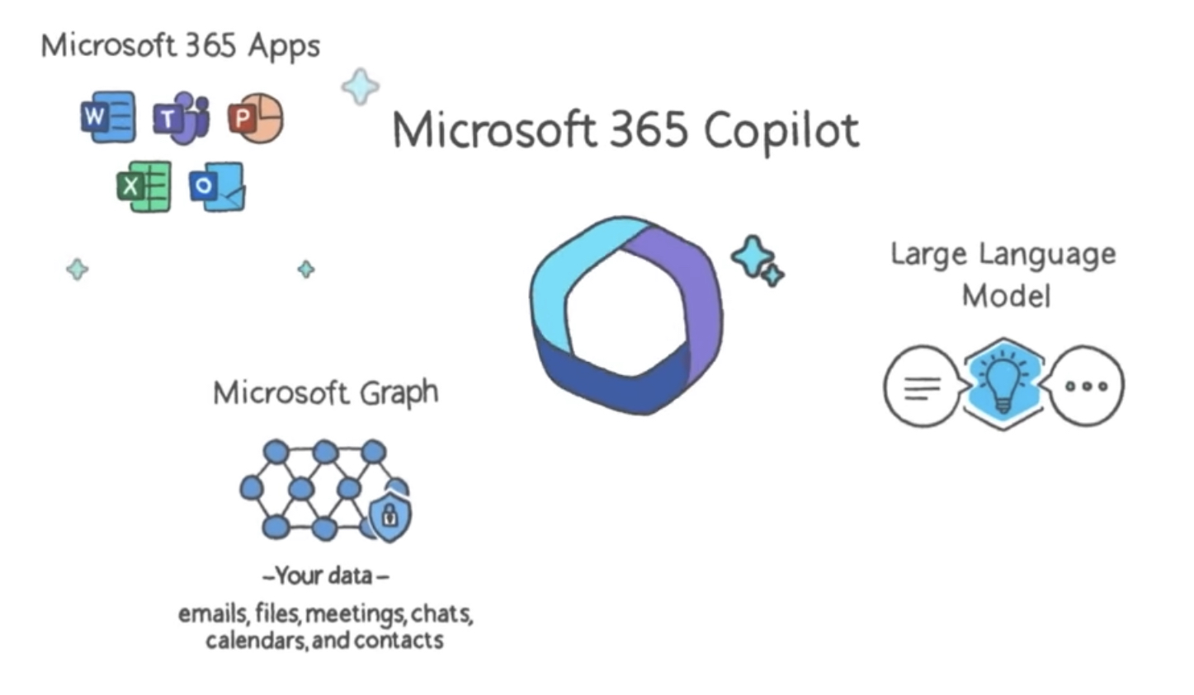
Copilot
Fully integrated in Microsoft Office, Apps, Edge & Bing

Slide 3


Slide 4
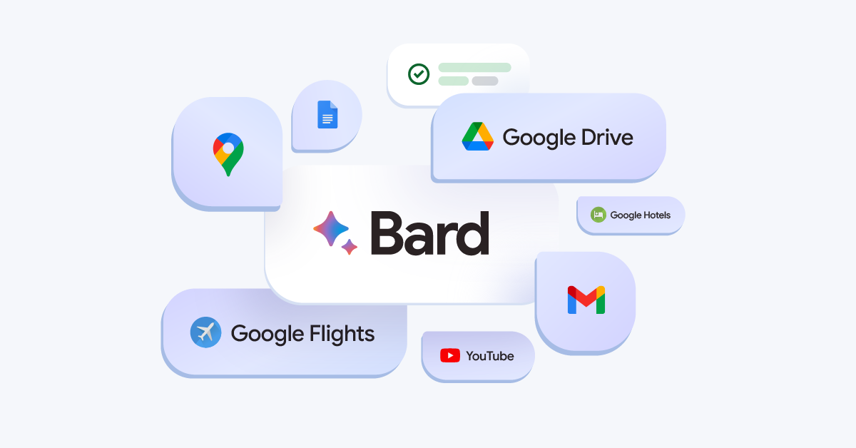
Google
Bard: fully integrated in a.o. Gmail, Drive, Youtube, Flights, Hotels & Docs

Slide 5


Modality:
Photo
Text
Speech
Music
Tools:
LinkedIn
ChatGPT
Resemble.AI
AIVA
“Teaching at a university has always been a profound passion of mine, as it allows me to be an integral part of shaping future generations by imparting knowledge, fostering critical thinking, and nurturing curiosity. The exhilarating environment of higher education not only fuels my desire to learn and grow, but also encourages my students to challenge themselves and become lifelong learners.”

Slide 6

Modality:
Photo
Text
Speech
Music
Tools:
Midjourney
ChatGPT
Resemble.AI
AIVA
“As an evil overlord teaching at a university, I take great pleasure in the boundless opportunities to make my students suffer. My nefarious passion for tormenting the minds of the young is fueled by the power I wield in shaping their future. I revel in the delight of witnessing their futile struggles as they navigate the treacherous waters of higher education.”

Slide 7
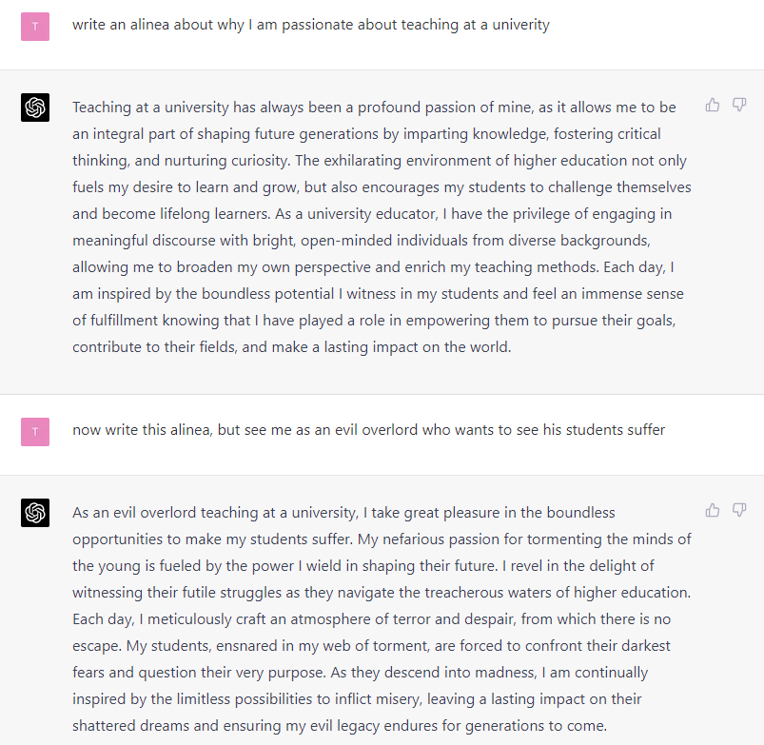

Slide 8
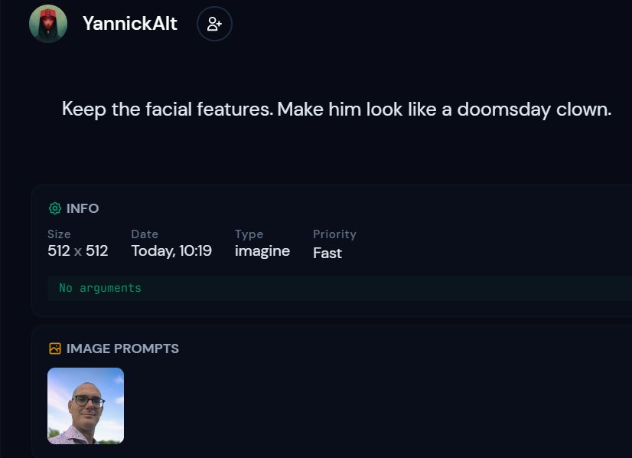

Slide 9
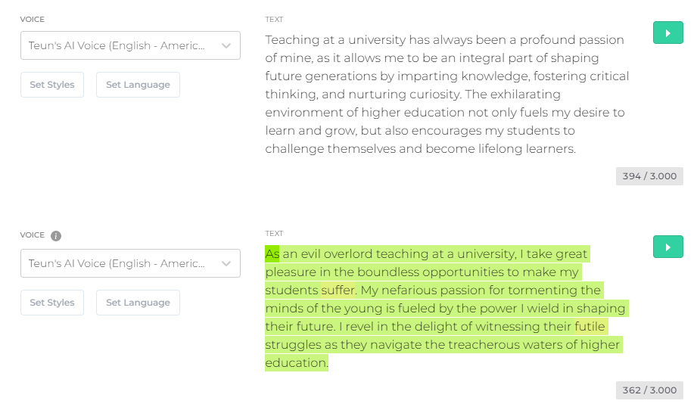

Slide 10
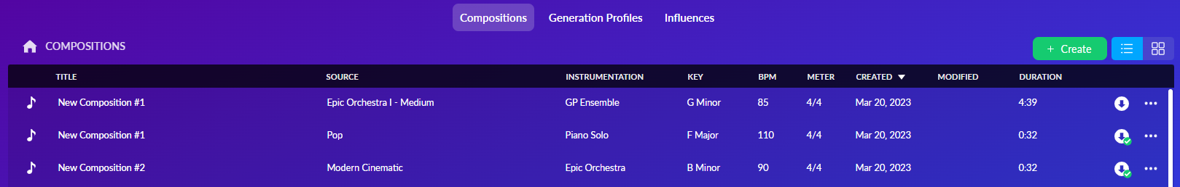

Slide 11
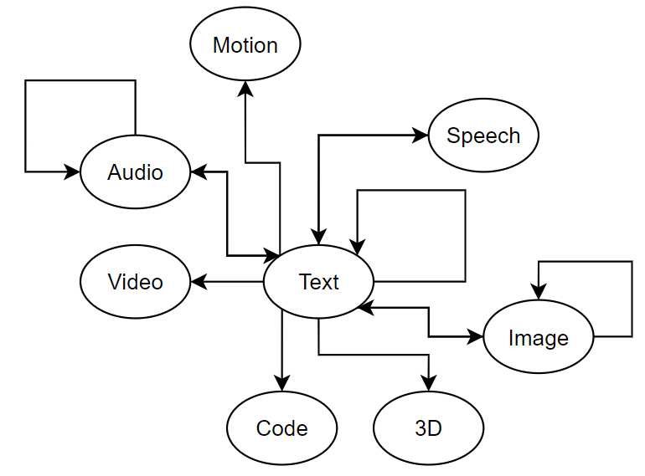
Multi modalities: from text, speech & camera to…
Generative A.I.
Camera

Slide 12
Multi modalities: from text, sketch & voice to…
Generative A.I.
Software engineering:
Developer tools
Data
Large Language Models
Project Management
Specialized:
Sales & Marketing
Manufacturing
Human Resources
Academic
Medical
Legal
Translation
…
Generic:
Tekst
Sketch
Image
Video
Voice
Music
Camera

Slide 13
Applying generative AI
What are we going to do?
Start applying the tools we showcased on your project.
Showcase to each other what tools you found and how you used them.
Then, make a roadmap for your project.
After that, we showcase the roadmaps to each other.
Tip; download the slides from the sharepoint to fill them in. windesheim.ai/workshop-ppt/

Slide 14

Start Applying the tools we showcased.
Applying Generative AI
<Project Name>
Replace me!
Use; Bing.com/create
<Gen AI Tool, prompt, use case>
<Gen AI Tool, prompt, use case>
<Gen AI Tool, prompt, use case>
<Gen AI Tool, prompt, use case>
<Gen AI Tool, prompt, use case>

Slide 15

hat’s the impact of Generative AI?

Slide 16
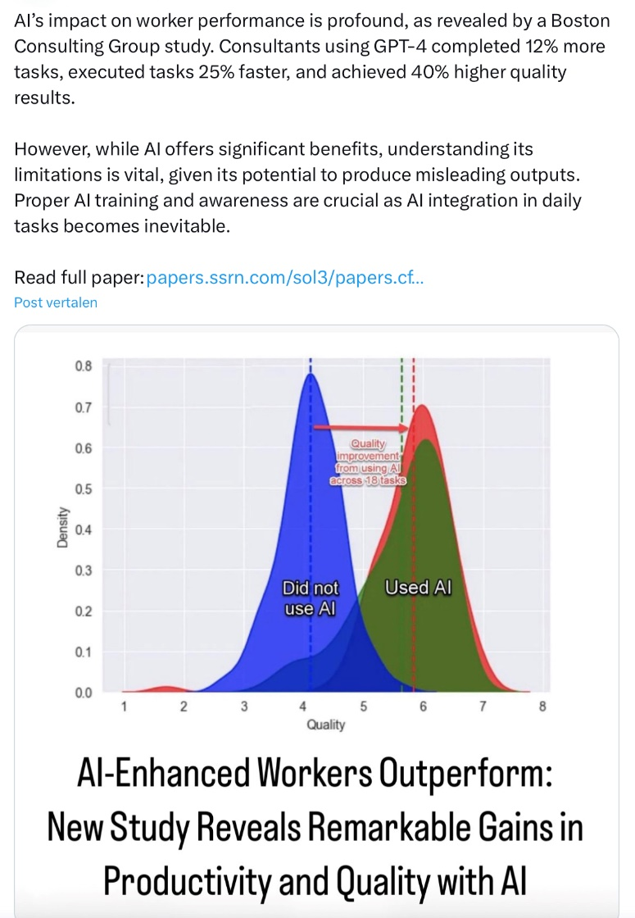

Impact on knowledge workers
Generative AI
Generative AI tools are improving the productivity of knowledge workers
AI LLM training cost decline continued at an annual rate of 70%
AI is expected to increase the productivity of knowledge workers more than 4-fold by 2030
Made with DALL-E: “Can you generate a picture of the productivity improvement for knowledge workers using generative AI? Make it funny and come with square picture showing faces of people”
Source: ARK Investment Management LLC and BCG/Harvard, 2023

Slide 17
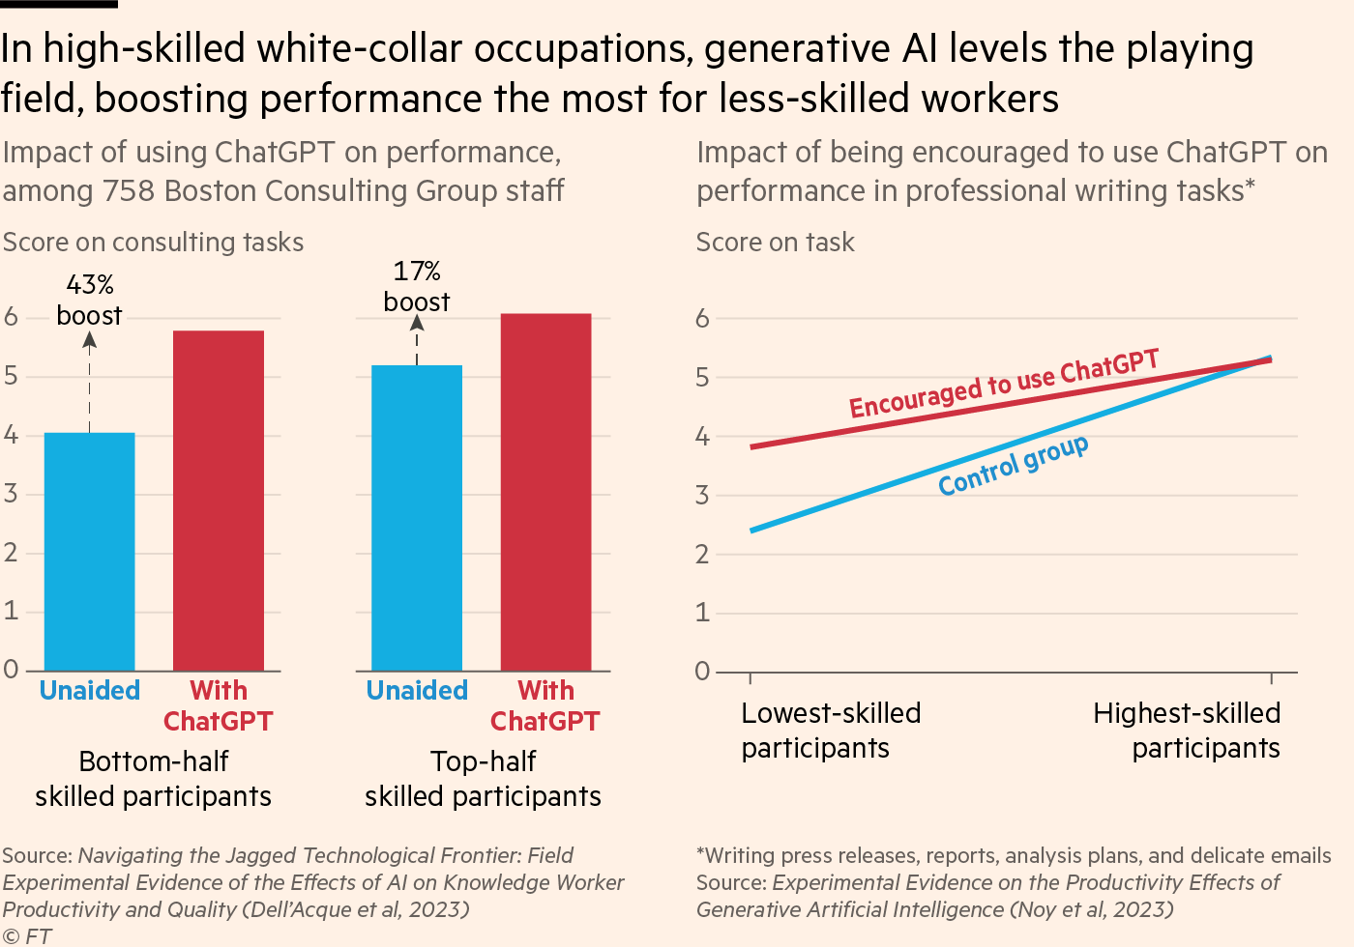

Slide 18
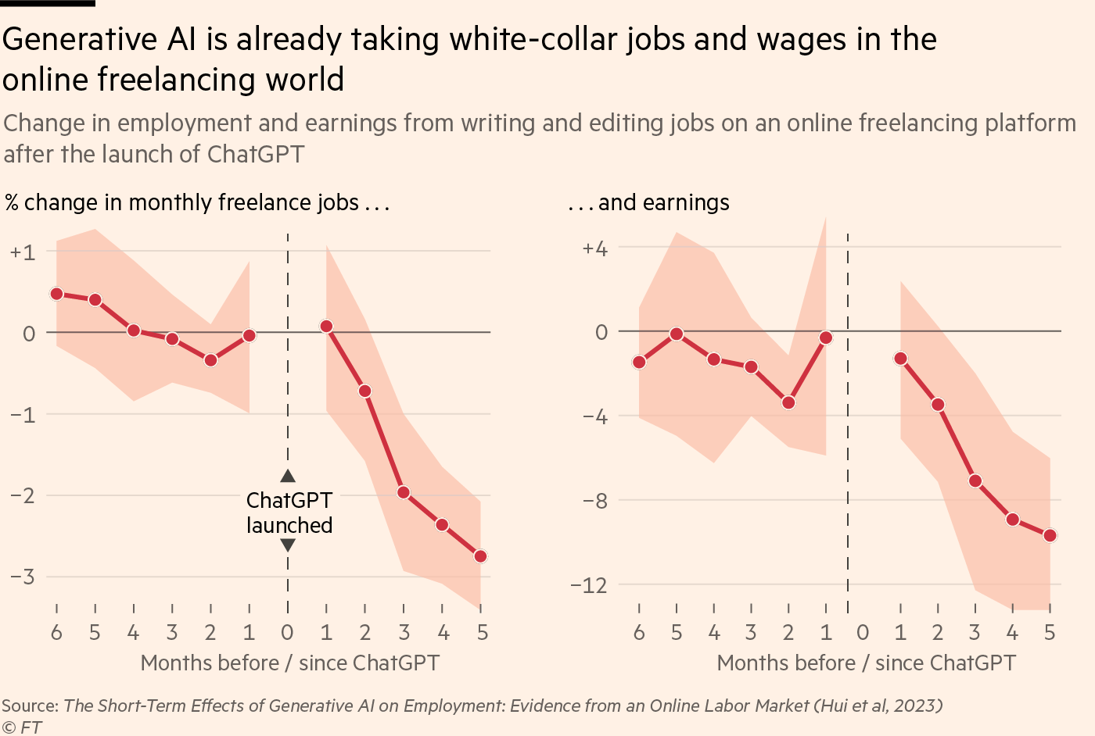

Slide 19
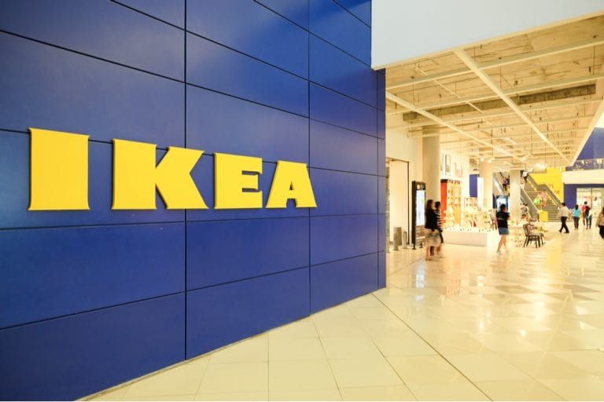
A.I. to Transform Call Center Employees Into Interior Design Advisors
Since 2021 : AI chatbot ‘Billie’ picked up 47% of the IKEA-chats
Then IKEA successfully trained 8,500 call center workers to serve as interior design advisers:
Providing a 45-minute to 60-minute interior design advice video call along with a recommended product list for a fee of € 30
Additionally, they can choose three workspace design consultations, a floorplan and 3D visuals for € 125
2022 : launch of IKEA Kreative experiential tool, which offers customers a free method to digitally design appealing and functional living spaces
The remote interior design channel, conducted via phone or video, amounted to 1.3 billion euros (about $1.4 billion), contributing 3.3% to the total revenue
Source: Reuters, June 14th 2023

Slide 20
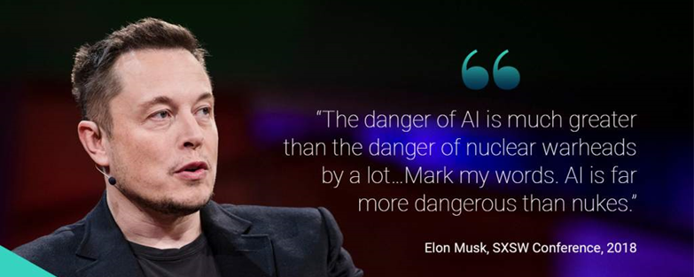
Isaac Asimov created in 1956 these three laws for robotics in I, Robot:
A robot may not injure a human being or, through inaction, allow a human being to come to harm.
A robot must obey orders given it by human beings except where such orders would conflict with the First Law.
A robot must protect its own existence as long as such protection does not conflict with the First or Second Law.

Slide 21
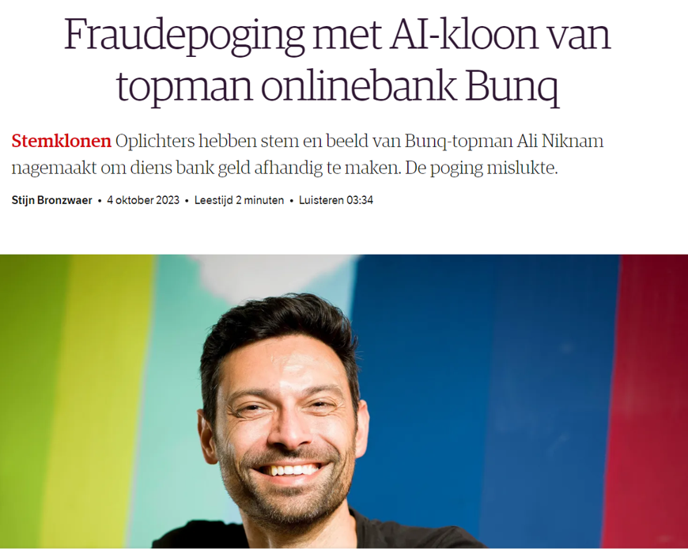

Slide 22
European A.I. Act
For A.I. developers and users
Due 2026 , early 2024: decision making
Four categories:
Unacceptable Risk: e.g. social scoring
High Risk: applications related to a.o. transport, education, employment and welfare e.g. HR ranking applicants based on algorithms
Low Risk: e.g. chatbots, potential IP infringement
Minimal Risk: e.g. spam filters, AI-enabled games, inventory management
Penalties up to 40 million Euro or 7% of the worldwide revenue if that is more than 40 million Euro
European database: register A.I. solutions for commercial use
Prepare the organisation: define A.I. use and requirements, explore your role and responsibilities, evaluate the A.I. output and human involvement and, finally, define the applicable risk levels and the related company policy

Slide 23
Intellectual-property, regulatory and other risks
Manage the risks using Gen AI
Data privacy and third-party security, such as the potential for designers to expose confidential information
Legal and regulatory changes, including changes to the European Union’s General Data Protection Regulation (GDPR) and the A.I. Act and other regulations limiting the use of the technology
A.I. behavioral vulnerabilities, including the impacts if bad actors plant malicious or malfunctioning code in the public domain to influence the training of large language models or infiltrate organizations
Ethics and reputational issues that could arise from using a design or a snippet of code copyrighted by another entity
Security vulnerabilities that can crop up in A.I.-generated code and put systems (and the organization) at risk.

